Slide 1
Cross Service
BS2-8-4, Software Project: Cross Service Artifact 4: Product Backlog
Product Backlog

Slide 2
Types of Users
BS2-8-4, Software Project: Cross Service Artifact 4: Product Backlog
Service Providers
Customers
Developers/Designers
Stakeholder(s)
Service providers offer service(s) to customers.

Slide 3
Types of Users
BS2-8-4, Software Project: Cross Service Artifact 4: Product Backlog
Service Providers
Customers
Developers/Designers
Stakeholder(s)
Service providers & customers are main actors in our user stories.

Slide 4
Epics
BS2-8-4, Software Project: Cross Service Artifact 4: Product Backlog
Implementing User Profile Management
Implementing Service Management
Developing Data Storage Mechanism
Supporting Notification Service(s)

Slide 5
Epic #1: Implementing User Profile Management
BS2-8-4, Software Project: Cross Service Artifact 4: Product Backlog
Features | Functions
Allow new user account creation | Web page with Registration Form. Web page with Login Form. Password recovery functionality.
Allow existing users to login to the system
Allow users to update/delete their account | Web page with options to edit/update account info.

Slide 6
Epic #2: Implementing Service Management
BS2-8-4, Software Project: Cross Service Artifact 4: Product Backlog
Features | Functions
Allowing service/request posting. | Creating a service/request page with ability to change/delete it.
Allow service/request editing/deletion.
Allow searching for service requests. | Searching for services by name, type, category, location, etc.

Slide 7
Epic #3: Developing Data Storage Mechanism
BS2-8-4, Software Project: Cross Service Artifact 4: Product Backlog
Features | Functions
Develop API to fetch data. | Provide functions to fetch data as requested by different app parts or developers.

Slide 8
Epic #4: Supporting Notification Service(s)
BS2-8-4, Software Project: Cross Service Artifact 4: Product Backlog
Features | Functions
Notify users about account, service/request updates. | Implement direct notifications through a bar in dashboard.
Implement fast notification features. | Notification by email. Notification by other services, e.g. telegram.

Slide 9
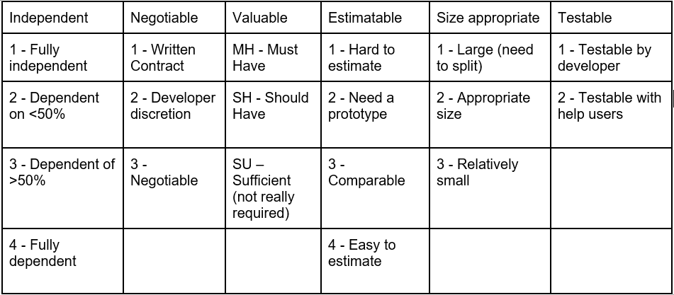
We defined our own INVEST criteria.
BS2-8-4, Software Project: Cross Service Artifact 4: Product Backlog

Slide 10
User Stories
BS2-8-4, Software Project: Cross Service Artifact 4: Product Backlog
Show the document file online while presenting for clear view.

Slide 11
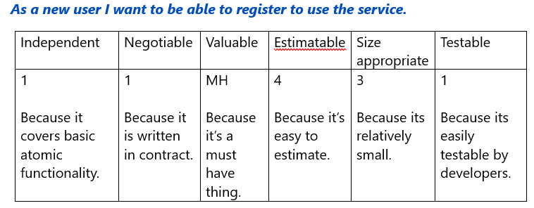
Selected User Stories & INVEST
BS2-8-4, Software Project: Cross Service Artifact 4: Product Backlog

Slide 12
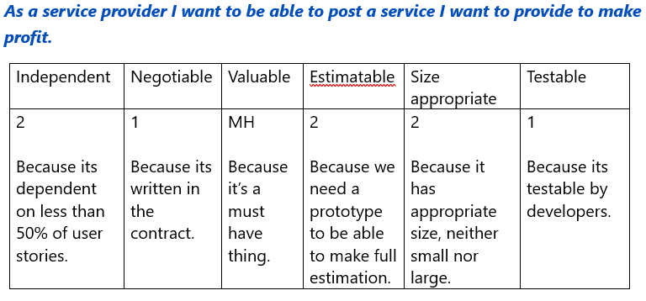
Selected User Stories & INVEST
BS2-8-4, Software Project: Cross Service Artifact 4: Product Backlog

Slide 13
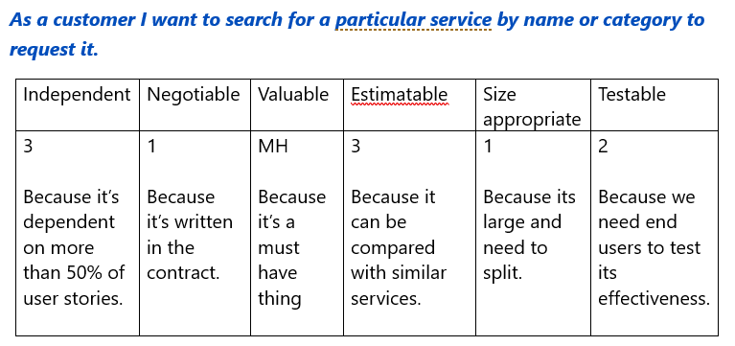
Selected User Stories & INVEST
BS2-8-4, Software Project: Cross Service Artifact 4: Product Backlog

Slide 14
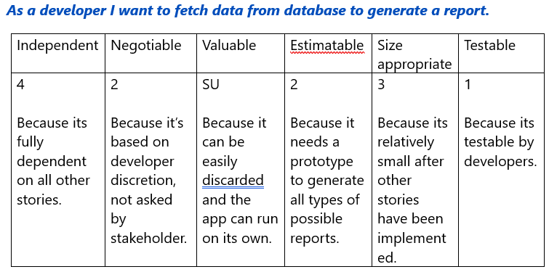
Selected User Stories & INVEST
BS2-8-4, Software Project: Cross Service Artifact 4: Product Backlog

Slide 15
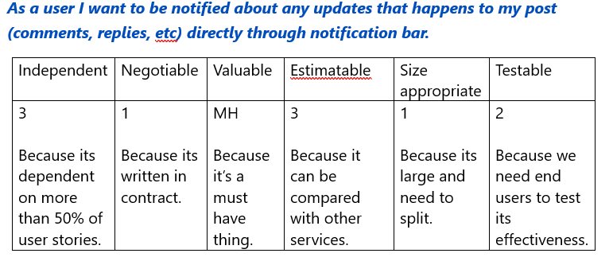
Selected User Stories & INVEST
BS2-8-4, Software Project: Cross Service Artifact 4: Product Backlog

Slide 16
Thank you for your time and attention!

